Slide 1
6502 ASSEMBLY
PRESS START
DealerOn
NICK ROGERS
2022
Notes:
Hi everyone. For those of you that don’t know, my name is Nick, I’m team lead of the Inventory team. Welcome to my tech talk. Today I am going to be talking about something that we may not have much use for here at DealerOn, but it’s something that’s interested me for a few years now, assembly language programming, specifically for the 6502 processor. That’s the brand of processor that powered many home computers and video game systems in the 70s and 80s. I’ve always been into retro gaming, as you can see here,

Slide 2
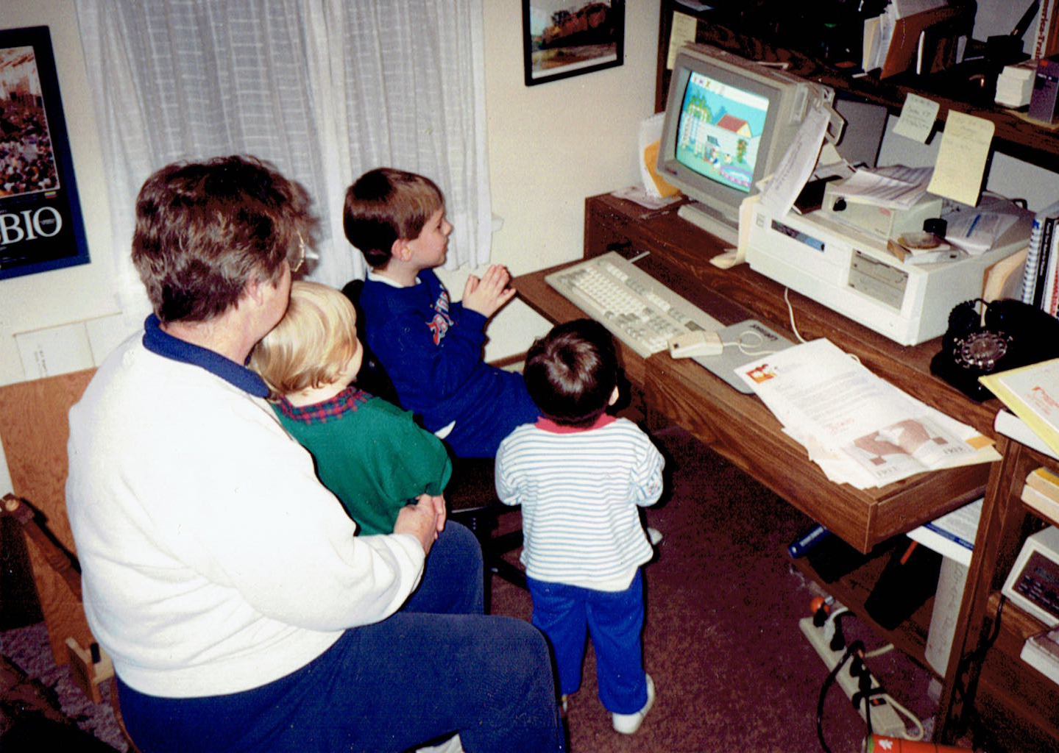
Notes:
This is me, circa 1994, with my grandma and cousin and brother, getting the high score on Donald Duck’s Alphabet Adventure for DOS. So I started pretty young with computers. Also, show of hands in the chat, who wasn’t born yet in 1994? I would like everyone to know that that computer is still there in my grandpa’s office. It runs Windows 98 now though.

Slide 3
LEVEL 1
ABOUT THE 6502

Slide 4
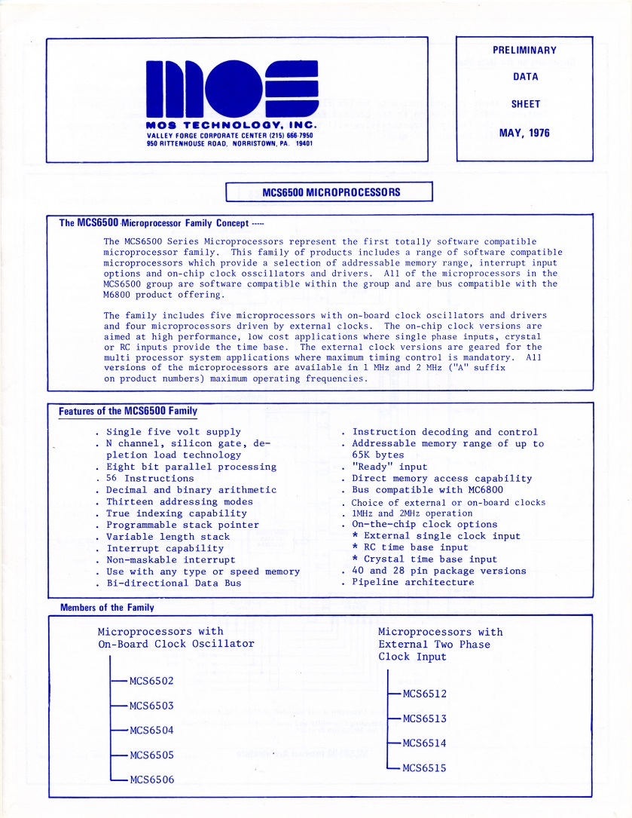
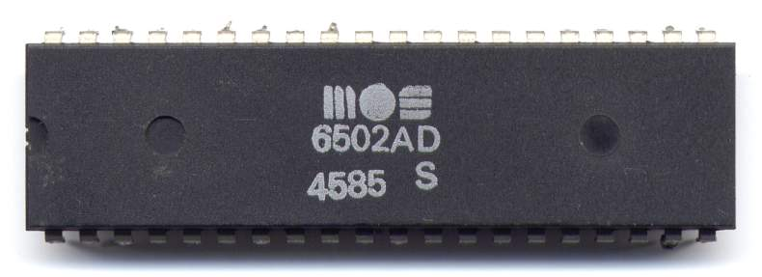
MOS 6502 PROCESSOR
Apple II
Atari 2600
Commodore 64
Nintendo NES
Tamagotchi
Notes:
MOS Technology is the company that introduced this chip architecture in 1975. They came out with the 6501, it was intended to be a cheaper drop-in replacement with a more expensive Motorola processor. Long story short, Motorola sued, the 6502 was born with just enough differences to make it incompatible. It was the chip of choice for those home computers and toys there, in fact Commodore wound up buying MOS in the late 70s.

Slide 5
COMPARISON
 | MOS 6502 | Intel Core i7-6700
Clock speed (ops/s) | 1 MHz | 3,400 MHz
Cores | 1 | 4
Threads/core | 1 | 8
Bit width | 8-bit data, 16-bit addresses | 64-bit
Max-addressable memory | 64 KB | 64 GB
Number of instructions | 56 | 2,000+
Price (today) | $20 | $300
Notes:
So here’s a fair comparison between 1975 and this present day Intel Core i7. You got a respectable 1 MHz for the MOS, 1 core, 1 thread. It’s called an 8-bit processor, but it does treat addresses, or memory locations, as 16 bits. 16 bits means you can address a maximum of 64 K of RAM. You have your choice of 56 instructions, which I’ll go over some of those in a little bit. And you can still buy them today, I found them going for about 20, 30 bucks on eBay. They work out really well for the PE6502, which is a hobby computer you can solder and put together yourself.

Slide 6


ASSEMBLY LANGUAGE
A program written in assembly language consists of a series of instructions intended to be executed directly by the computer’s processor.
A text file containing assembly language instructions is assembled into object files containing machine language and then linked into an executable program.
A
S
S
E
M
B
L
E
R
program.o
LINKER
program.asm
program.exe
header.asm
header.o
Notes:
The difference between assembly and machine language. Machine language is the only thing a processor truly understands, it’s the raw bytes of your program. You can program directly in machine language, but it’s a lot of bother, whereas assembly has some mnemonics and convenience features to make things a bit easier to work with. When you program in assembly language, you use an assembler and a linker. After running your assembly code through the assembler, you get object files, which contains code which is not directly executable, but it’s close. For that you need the linker, which resolves references to external libraries and system functions and writes a properly-formatted executable.

Slide 7
MACHINE LANGUAGE
Assembly language is composed of opcodes and operands, mnemonics for machine language. There is usually a 1 to 1 correspondence between assembly and machine language.
Opcodes
Operands
Opcodes
Operands
LDA $0400
CMP #$64
BNE $8010
INC $0410
LDA #$00
STA $0400
AD 00 04
C9 64
D0 08
EE 10 04
A9 00
8D 00 04
6502 Assembly
6502 Machine
Notes:
Now here is your first taste of 6502 assembly language, and how it translates to machine language. On the left are opcodes, or the commands we’re running, and the operands, or arguments. Again, machine language is the only thing a processor understands, but you can see that things mostly translate over pretty cleanly. I’ll go over what it all means on the next slide. The only thing you may notice is that these values here with the dollar sign are transposed. These are opcodes working with memory addresses, and in the 6502 architecture, memory addresses are little-endian. That means that the more significant digits of the value are at the end, instead of the beginning like our regular number system. Any questions?

Slide 8
INTRO TO ASSEMBLY LANGUAGE
Load the value in memory location 0x0400
Compare it with 0x64 (dec 100)
Branch (skip) later in the program if they are not equal
Increment the value in memory location 0x0410
Load 0x00 (dec 0)
Store it in memory location 0x0400
#: Literal value
$: Hexadecimal value
%: Binary value
LDA $0400
CMP #$64
BNE $8010
INC $0410
LDA #$00
STA $0400
SMB1 Disassembly: https://gist.github.com/1wErt3r/4048722
Notes:
So what the heck does this all mean, anyway? Well, this is the actual code from Super Mario Bros, when you get 100 coins you get a free life. And I’ll explain some of the extra syntax as well, the number sign means literal value, so we mean the actual number instead of the value in a memory address. The dollar sign means the value following is hexadecimal, and the percent sign means binary. And again, this is what I pulled from the actual Mario Bros. source code. This is what it actually looks like.

Slide 9
INTRO TO ASSEMBLY LANGUAGE
GiveOneCoin:
lda #$01 ;set digit modifier to add 1 coin
sta DigitModifier+5 ;to the current player's coin tally
ldx CurrentPlayer ;get current player on the screen
ldy CoinTallyOffsets,x ;get offset for player's coin tally
jsr DigitsMathRoutine ;update the coin tally
inc CoinTally ;increment onscreen player's coin amount
lda CoinTally
cmp #100 ;does player have 100 coins yet?
bne CoinPoints ;if not, skip all of this
lda #$00
sta CoinTally ;otherwise, reinitialize coin amount
inc NumberofLives ;give the player an extra life
lda #Sfx_ExtraLife
sta Square2SoundQueue ;play 1-up sound CoinPoints:
SMB1 Disassembly: https://gist.github.com/1wErt3r/4048722
Notes:
You can see that in most assemblers you can use labels instead of direct memory addresses, that’s helpful instead of needing to keep track of which memory address is what. This code is mostly what I said before, just with some extra stuff for playing sound. Labels can be really clutch, you can define them in your program header and then reference memory locations by name instead of value. You have to be really careful to not have an off by one error, because then you’re suddenly executing operands as opcodes and everything falls apart on you. One thing I’ll point out at the top is that we have LDA, LDX, and LDY. A, X, and Y are all processor registers, or storage locations for values inside the processor.

Slide 10
PROCESSOR REGISTERS
Most operations cannot be performed directly on values in memory. The value must be loaded into a register in the processor and then stored back into memory later.
A
A is the accumulator. Values are loaded into A to have mathematical and logical operations performed on them.
X
Y
X and Y are index registers, typically used as counters in loops, but can also temporarily store values like A does.
P
P is the processor status register. It is a read-only register which contains a byte whose bits represent information about the processor’s status and the result of the previous operation.
SP
The stack pointer holds the low byte of the address of the item on the top of the stack. This pointer is decremented when items are pushed onto the stack and incremented when items are popped off.
PC
The program counter holds the 16-bit address of the currently executing instruction. Its value is pushed to the stack when a subroutine begins so the processor knows where to return to.
Notes:
Modern processors have these registers as well, even today it’s much slower and wasteful to write a value to main memory every time. That’s why sometimes you see L1 and L2 cache. It’s much faster and more efficient to keep values inside the processor if you’re going to be operating on them or if you’re going to use them again shortly. A is the accumulator, it’s the most commonly used register. X and Y are typically used as counters for a for loop, but can also store values just like the accumulator. P is a special value which stores information about processor status. There’s a stack, it’s 256 bytes. It’s a descending stack, meaning the item on the bottom of the stack is stored at the very end of the memory allocated for the stack. And the program counter stores the address of the currently executing instruction. When you enter a subroutine, the value of PC is pushed onto the stack so it knows where to return when exiting.

Slide 11
ALL 56 OPCODES
Almost all of these operations deal with either numbers or program flow.
ADC | AND | ASL | BCC | BCS | BEQ | BIT | BMI
BNE | BPL | BRK | BVC | BVS | CLC | CLD | CLI
CLV | CMP | CPX | CPY | DEC | DEX | DEY | EOR
INC | INX | INY | JMP | JSR | LDA | LDX | LDY
LSR | NOP | ORA | PHA | PHP | PLA | PLP | ROL
ROR | RTI | RTS | SBC | SEC | SED | SEI | STA
STX | STY | TAX | TAY | TSX | TXA | TXS | TYA
Notes:
Like I said, there are 56 opcodes, and almost all of them deal with modifying numbers or with control flow. I won’t go into all of them, but I’ll touch on some of the major ones.

Slide 12
ADDRESSING MODES
The lda instruction loads a value into the processor’s accumulator (A). Where that value comes from depends on what addressing mode is used.
Instruction | Op | Name | CPU Cycles | Description
lda #$42 | A9 | Immediate | 2 | Loads the literal value 42 in hex (dec 66)
lda $42 | A5 | Zero Page | 3 | Loads the value in memory location 0x0042
lda $42,X | B5 | Zero Page Indexed | 4 | Loads the value in 0x0042, offset by X
lda $4200 | AD | Absolute | 4 | Loads the value in 0x4200
lda $4200,X | BD | Absolute Indexed | 4 | Loads the value in 0x4200, offset by X
lda $4200,Y | B9 | Absolute Indexed | 4 | Loads the value in 0x4200, offset by Y
Notes:
Let’s start first with LDA, which means load a value into the accumulator. Each opcode supports multiple addressing modes, meaning where does the value come from. You can see there that these are all LDA, but the opcode differs based on where the value is loaded from. There’s immediate, which means load the literal value hex 42 into the accumulator. The rest are for memory locations. There’s a special case for the “zero page” or the first 256 bytes of memory. Pages of memory are 256-byte groups of memory (x0 through xFF for example). For the CPU Cycles column, that is roughly how long it takes the CPU to perform that operation. The zero page operations are a bit faster, simply because there’s one less byte to process. Now saving one CPU cycle doesn’t sound like much, even for a 1 MHz processor, but there were some times when programmers had to be really cognizant of the performance of their code. I’ll have more on that later.
For the ones that say indexed, that’s loading the memory address, but offset by the value that’s in the X or Y register. So that isn’t a variable I have there, it relies on the value that is in the X or the Y register when that operation runs.

Slide 13
INDIRECT ADDRESSING
There are also two load instructions which use indirect addressing. The address being loaded must be in the zero page and the offset register must be used.
Instruction | Op | Name | CPU Cycles | Description
lda ($42,X) | A1 | Indexed Indirect | 6 | Loads the value in the address stored in (0x0042+X) and (0x0042+X+1)
lda ($42),Y | B1 | Indirect Indexed | 5 | Loads the value in the address, offset by Y, stored in 0x0042 and 0x0043
Notes:
And there are also two indirect addressing modes, which basically act as a pointer to a different value. The operand must be in the zero page and you have to set either the X or the Y register. The first one there, indexed indirect, the offset is applied to the argument, and the second one the offset is applied to the result. So that’s all the addressing modes there are, let’s talk about some loads and stores.

Slide 14
LOADING AND STORING
More “Load” and “Store” instructions:
Instruction | Name | Description
lda ADDR | Load Accumulator | Loads the value in ADDR into A
ldx ADDR | Load X | Loads the value in ADDR into X
ldy ADDR | Load Y | Loads the value in ADDR into Y
sta ADDR | Store Accumulator | Stores the value of A into ADDR
stx ADDR | Store X | Stores the value of X into ADDR
sty ADDR | Store Y | Stores the value of Y into ADDR
ADDR can be an address or a literal value for load instructions.
Notes:
This is pretty straightforward, LDA loads into accumulator, LDX into X, LDY into Y. STA stores into accumulator, STX into X, STY into Y. And for all that, ADDR is any memory location or literal value. Except for the stores, you can’t store over a literal value.

Slide 15
COMPARISONS
Conditional expressions consist of a compare instruction followed by a branch instruction.
Instruction | Name | Description
cmp ADDR | Compare Accumulator | Compares the accumulator with ADDR
cpx ADDR | Compare X | Compares X with ADDR
cpy ADDR | Compare Y | Compares Y with ADDR
How is the result of the comparison encoded in the 6502?
Notes:
Conditionals work somewhat similarly, you have CMP, CPX, and CPY, and it compares the specified register with the value in the specified memory location. This needs to be followed by a branch operation to transfer execution to a new memory location, and the branch operates on the result of the comparison. How is the result stored?

Slide 16
PROCESSOR STATUS REGISTER
P
P is the processor status register. It is a read-only register which contains a byte whose bits represent information about the processor’s status and the result of the previous operation.
Carry: Previous operation resulted in a carry
Zero: Previous operation resulted in 0 value
Interrupt: Interrupts enabled
Decimal: Decimal (BCD) mode enabled
oVerflow: Previous operation resulted in an overflow
Negative: Bit 7 of the previous operation, 1 if negative
NV--DIZC
Notes:
In P, the processor status register. This is a byte with 6 bit flags that get set based on the results of every operation in the CPU. Z is the most important flag you would check, that bit would be set when a 0 value was loaded into a register. It would then remain set so you’d then need to manually turn it off after checking it. That’s actually kind of annoying, if you try to add without clearing the carry flag, it assumes there was a carry previously and it adds 1 to the result. Z, C, and N would all be set in different ways after comparing two values.

Slide 17
COMPARISONS
A comparison of two values is performed by simply subtracting the memory value from the register value, setting the following processor flags accordingly:
Comparison Result | N | Z | C
A = B | 0 | 1 | 1
A < B | B7 | 0 | 0
A > B | B7 | 0 | 1
Where A is the register value and B is the memory value or literal. The N flag is set to bit 7 of the subtraction operation.
Notes:
A comparison is really just subtracting the two values. If they are equal, the Z flag would be set, if they aren’t, it would be cleared. You can then determine less than or greater than by checking the C flag. Ultimately, all these flags are used for flow control operations.

Slide 18
BRANCHES AND CONTROL FLOW
Control flow is typically managed by branch operations after a comparison operation has been executed and the processor flags have been appropriately set.
Instruction | Op | Name | Description
bpl VAL | 10 | Branch on Plus | Previous result was positive
bmi VAL | 30 | Branch on Minus | Previous result was negative
bvc VAL | 50 | Branch on Overflow Clear | Overflow flag (V) is not set
bvs VAL | 70 | Branch on Overflow Set | Overflow flag (V) is set
bcc VAL | 90 | Branch on Carry Clear | Carry flag (C) is not set
bcs VAL | B0 | Branch on Carry Set | Carry flag (C) is set
bne VAL | D0 | Branch on Not Equal | Zero flag (Z) is not set
beq VAL | F0 | Branch on Equal | Zero flag (Z) is set
VAL is the number of bytes to branch forward or backward. VAL can be in the range [-128, 127]. What if we want to branch by more?
Notes:
VAL is a signed integer, it means the number of bytes to move forward or backward in the program. We’re limited to this range of values, however we do have the ability to jump directly to program addresses.

Slide 19
MORE CONTROL FLOW
Branch operations are relative. These control flow instructions are non-relative:
Instruction | Op | Name | Description
jmp ADDR | 4C | Unconditional Jump | Transfers program execution to ADDR
jmp (ADDR) | 6C | Indirect Jump | Transfers program execution to the value located in ADDR and ADDR+1
jsr ADDR | 20 | Jump Subroutine | Pushes current PC address onto stack and then transfers program execution to ADDR
rts | 60 | Return from Subroutine | Pulls address from top of stack and transfers program execution there
rti | 40 | Return from Interrupt | Pulls processor status and then address from stack and transfers program execution there
Notes:
Jump is the equivalent of a goto. You can jump directly or indirectly. JSR is a jump with also pushing the current program counter onto the stack so it knows where to return to when you hit RTS, return from subroutine. RTI is used for interrupts, that’s where it pulls the value of the P register from the stack as well.

Slide 20
MORE CONTROL FLOW
“Long branches” can be achieved by inverting the condition and adding a jmp instruction to the intended target. The jmp instruction will be skipped if the inverted condition is true.
CMP #$0A
BEQ $96F3
CMP #$0A
BNE :+
JMP $96F3
:
Error: Range error (1949 not in [-128..127])
Shorthand for “the next colon label”
Notes:
Going back to branches, if you want to branch for more than 128 bytes, you will get an error when assembling your code if you try to do that. What you can do instead is invert the condition to branch a single instruction and then do an unconditional jump to the target that you wanted. The assembler I’m using is called ca65 and it actually does do this behind the scenes, as well as support the colon-plus syntax you see there.

Slide 21
BITWISE OPERATIONS
Instruction | Name | Description
and ADDR | AND with Accumulator | Bitwise AND
bit ADDR | Bit Test | Bitwise AND, sets P flags without modifying A
ora ADDR | OR with Accumulator | Bitwise OR
eor ADDR | XOR with Accumulator | Bitwise XOR
asl ADDR | Arithmetic Shift Left | Shift all bits left one position, 0 shifted into bit 0, bit 7 shifted into C
rol ADDR | Rotate Left | Shift all bits left one position, C shifted into bit 0, bit 7 shifted into C
ror ADDR | Rotate Right | Shift all bits right one position, C shifted into bit 7, bit 0 shifted into C

Slide 22
ARITHMETIC OPERATIONS
Instruction | Name | Description
adc ADDR | Add with Carry | Stores the result of A+C+ADDR in A
sbc ADDR | Subtract with Carry | Stores the result of A-ADDR-(1-C) in A
inc ADDR | Increment | Adds 1 to value in ADDR
inx | Increment X Register | Adds 1 to value in X register
iny | Increment Y Register | Adds 1 to value in Y register
dec ADDR | Decrement | Subtracts 1 from value in ADDR
dex | Decrement X Register | Subtracts 1 from value in X register
dey | Decrement Y Register | Subtracts 1 from value in Y register
Notes:
There isn’t anything for multiplication or division, you may have to get clever with shifting bits and adding in a loop.

Slide 23
LEVEL 2
DEVELOPING FOR
THE NINTENDO NES

Slide 24
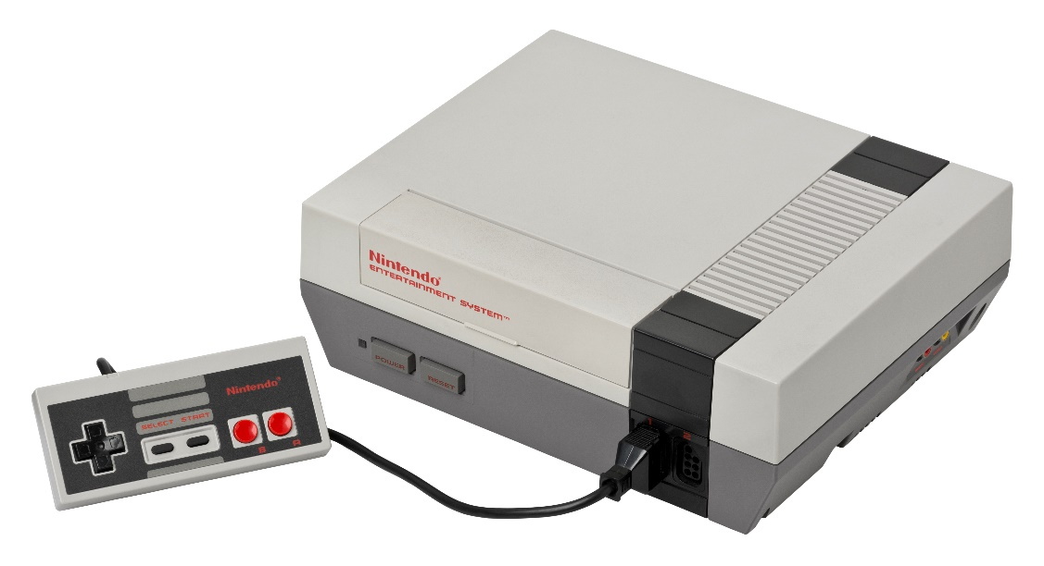
NINTENDO ENTERTAINMENT SYSTEM
Specification | Value
CPU | Ricoh 2A03 (6502 compat.)
PPU | Ricoh 2C02
Work RAM | 2 KB
Video RAM | 2 KB
Display resolution | 512 x 480 pixels (256 x 240 pixels visible)
Colors | 48
Sound channels | 2 square waves, 1 triangle wave, 1 white noise, 1 PCM
Notes:
Here are the hardware specs of the NES. The CPU is that chip made by Ricoh, it’s 100% compatible with the 6502 architecture. The PPU is the graphics chip. You got a generous 2 kilobytes of work RAM and video RAM. The display resolution is 512 by 480 pixels, but only a quarter of that, 256 by 240 was visible on the screen at a time. The off-screen regions were used either for setting up graphics, or for implementing scrolling. I’ll have more on that a little bit later. Finally there are 48 colors, and 5 sound channels. 2 main square waves, 1 triangle wave for bass notes, 1 white noise for percussion, and 1 for PCM encoded digital audio. That was rarely used because game cartridges usually didn’t have enough space to store much audio.

Slide 25
MEMORY MAP
Work RAM: 0x0000 – 0x07FF (2KB)
Mirrors of Work RAM: 0x0800 – 0x1FFF (2KB repeated)
PPU Registers and Mirrors: 0x2000 – 0x3FFF (8 bytes repeated)
Graphics Data: 0x4000 – 0x7FFF (16 KB)
Game Cartridge: 0x8000 – 0xFFFF (32 KB)
Notes:
Here’s a map of the NES’s system memory. There’s 64 K of RAM, the first 2K is the work RAM, that’s basically your workspace for the currently running game cartridge. That runs from 0 to 7FF. Then after that, there’s three additional mirrors of the work RAM. Certain regions are duplicated, or mirrored, in the NES’s memory, simply because it allows the CPU to ignore some of the bits of a memory address. The CPU can be doing a lot, and if it can get by with not setting all of the bits of an address, so it can be more performant at the cost of some memory. The green section here is actually 8 bytes, repeated over and over for 8K. These are some special memory locations mapped to the graphics chip, and because they’re so frequently used, the CPU wants to be as sloppy as it can because fast performance there is critical. Then there’s 16K for graphics data, for the graphics tiles currently on the screen, and finally 32K for the game cartridge. The game cartridge is plugged directly into the system memory. One thing that may help if you’re a modern developer doing this, pretend all you have to work with is C# byte 2048 array.

Slide 26
MEMORY MAP
NES
???
Mega Man 2
256 KB
Notes:
So again, that’s 32K for the game, but most games are larger than 32 K. I looked it up, and Mega Man 2 is 256K. Some games were up to 1 MB. Remember how the CPU can’t address anything past 64 KB? How can games be larger than that, then, and still work on the system? Does anyone know what they do there?

Slide 27
MEMORY MAP
NES
Mega Man 2
256 KB
PRG0
PRG1
PRG2
PRG3
PRG4
PRG5
PRG6
PRG7
PRG8
PRG9
PRGA
PRGB
PRGC
PRGD
PRGE
PRGF
Notes:
Most games support something called bank switching. The cartridge comes with some special hardware called a mapper to allow the cartridge to swap out which 16K regions are accessible by the CPU. Typically that was handled by the CPU attempting to read a special memory address mapped to the cartridge, and the cartridge intercepting that and re-mapping which banks of memory are being presented to the system.

Slide 28
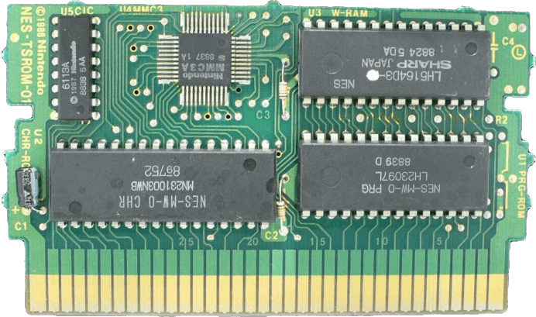
ANATOMY OF AN NES CARTRIDGE
Mapper
RAM (optional)
CIC (Lockout Chip)
Character ROM
Program ROM
Notes:
Your typical NES cartridge had a few different components. Starting from the bottom right and moving clockwise, the program ROM had all of your game code, all the machine code bytes baked into the chip. Then the character ROM which had your graphics tiles in an encoded format. The CIC chip is Nintendo’s DRM, games wouldn’t load up if that chip wasn’t present and you had to be a licensed developer in order to get that chip. The mapper is the hardware that handles the bank switching I just talked about. And finally there’s an optional RAM chip that can augment the 2 KB of system RAM, or it can be used for saved game files. If it’s being used for saved games you’d typically also find a battery to keep the RAM powered, to persist its data.

Slide 29
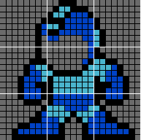
GRAPHICS
NES graphics are composed of 8x8 pixel tiles in the game’s character ROM. These tiles can be sprites or background tiles.
Sprites are graphical elements on the screen that can move, be animated, or change color. Sprite data is stored in OAM, a special 256-byte range of memory. Each sprite’s data is 4 bytes, therefore a maximum of 64 sprites can be visible on the screen at once.
Byte 0: Y position
Byte 1: Tile index
Byte 2: Attributes (color palette, Z position, flip horizontal, flip vertical)
Byte 3: X position
Background tiles must be aligned to an 8x8 grid, but there is no limit to the amount that can be on the screen.
MARIO
056200
Notes:
All the graphics in an NES game are 8 by 8 tiles, you can’t draw lines or shapes, you have to compose all your graphics using tiles that are defined in the game’s ROM. These tiles can be sprites or background tiles. Sprites are typically tiles that the player can interact with. They can move independently of the background layer, are animated, or change color. They’re stored in a range of memory called OAM, it’s 256 bytes so a maximum of 64 sprites can be on screen at once. There’s no limit to how many background tiles can be on the screen at once, but they do need to be aligned to an 8 by 8 grid. They’re typically used for things that don’t move on the screen, like your score or the level background.

Slide 30
BACKGROUND GRAPHICS
Background graphics are stored in 4 nametables, areas of the NES’s RAM. Each byte of each nametable controls an 8x8 pixel region of the screen. To display a specific background tile, you simply need to place its tile index in the desired location.
(0,0)
1 0x2000 | 2 0x2400
3 0x2800 | 4 0x2C00
Because the NES does not have enough RAM to handle four nametables, two of the regions will be mirrored.
Vertical mirroring: Nametables 1 == 3 and 2 == 4
Horizontal mirroring: Nametables 1 == 2 and 3 == 4
One-screen mirroring: All nametables are the same
A smooth “scrolling” effect can be achieved by rapidly incrementing the bounds of which region is visible on the screen.
(511, 479)
Notes:
Earlier I mentioned that only a small region of the total resolution can be displayed on the screen. These four regions are called nametables, and these are the regions dedicated to the on-screen graphics. Each byte of each nametable controls an 8x8 region of the screen, and to display a specific background tile, you simply need to store the tile index in that desired location. But there’s a catch, the NES doesn’t have enough RAM to handle these four regions distinctly, so two of the regions are mirrored. You use vertical mirroring when you want nametables 1 and 3 to be the same, and horizontal mirroring when you want 2 and 4 to be the same. You can also do a scrolling effect, like you would see in a Mario game as you run along the stage by using vertical mirroring and incrementing the bounds of the region that’s visible on the screen. I’ll show some examples on this in a bit.

Slide 31
“RACING THE BEAM”
A CRT-style television draws an image to the screen one pixel at a time with an electron scanning beam. After drawing a complete row on the screen, the beam is switched off and then sweeps back to the start of the next row (H-Blank). Once it reaches the bottom and draws the final pixel, the beam is switched off and it returns to the home position to draw the next frame (V-Blank).
Drawing a frame of video: 14.23 ms
V-Blank: 2.41 ms
H-Blank: 15.69 μs*
* Too brief to do anything useful
Notes:
The NES had interrupts that triggered whenever V-Blank and H-Blank happened. The NES ran at 60 frames per second in NTSC. That’s better than X-Box at least. “Racing the beam” refers to the need to divide the work you’re doing into game logic and graphics logic. This may sound like a pain, but it was way more frustrating for earlier systems like the Atari. On that system, you really didn’t have much of a choice except work a few pixels ahead of the scanning beam, and if you weren’t quick enough, or if you weren’t perfectly in sync with the TV, you’d just be drawing garbage to the screen.

Slide 32
V-BLANK
For every frame of video, an NMI is generated for the V-Blank period. This is the period of time when the PPU is “resting”. When the NMI is raised, the game immediately jumps to your predefined NMI address and runs your code related to preparing graphics to be drawn.
1 video frame: (~30,000 cycles)
PPU Active
V-Blank (~2,250 cycles)
Game logic should be run while the PPU is active and graphics code should be run during V-Blank. It’s important not to attempt to draw to the screen outside of the V-Blank period, otherwise strange artifacts can appear on the screen. You can reliably copy about 160 bytes worth of data during V-Blank. If you have a lot of drawing to do, the PPU can be disabled and then game and graphics logic can be mixed.
Notes:
Some more about V-Blank, once the beam hits the bottom of the screen and travels back to the home position, an NMI is raised, or a non-maskable interrupt. While the PPU is active, you need to run both your game logic, and also write into buffers what graphics changes need to happen, whether changes to sprites or the background. Also it’s important to not attempt to draw to the screen outside of V-Blank, otherwise really weird stuff can happen, like garbage appearing on the screen or the game crashing. During the V-Blank period, you need to write your buffered graphic data to the screen. You can reliably copy about 160 bytes of data during V-Blank, so if you have a large transition to do, you can either break it up into several frames, or just disable the PPU to blank the screen and you can do all your changes at once.

Slide 33
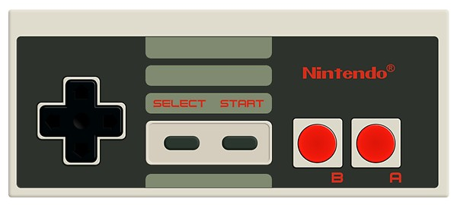
CONTROLLER INPUT
Controller input is mapped to two locations in memory: 0x4016 for controller 1 and 0x4017 for controller 2. Each button is mapped to a bit, which can then be ANDed to determine if it is being pressed or not.
00000000
Notes:
Last thing I’ll talk about is controller input. Your controller input is mapped to 0x4016 for controller 1 and 0x4017 for controller 2. Each button on the controller corresponds to a bit in these memory locations. So for example if I hold up and A,

Slide 34
CONTROLLER INPUT
Controller input is mapped to two locations in memory: 0x4016 for controller 1 and 0x4017 for controller 2. Each button is mapped to a bit, which can then be ANDed to determine if it is being pressed or not.
$88 =
10001000
Notes:
That translates to hex 88, and I can AND that value to determine which buttons are being held down.

Slide 35
LEVEL 3
MARS ROVERS
...THE GAME!
Notes:
Ok, that’s the end of this PowerPoint, next thing I’m going to do is demo some NES games and attempt to show what’s actually going on in the system while you’re playing a game.

